Slide 1
Food Allergen Liability and Regulation When Consumer Label Reading Effort Counts
Maria Arbatskaya,
Emory University marbats@emory.edu
Maria Vyshnya Aslam,
Emory University mvyshny@emory.edu
May 30, 2013

Slide 2
Emphasis
Consumer information about product risk (allergen content in food)
Industry regulation: labeling mandates set by the government
Main Novelty:
Endogeneity of consumer reactions to warnings
Policy Outcome:
Design of labeling mandates
Disclosure standard
Clarity of the warning message

Slide 3
Facts About Allergies:
The main treatment is to avoid foods containing allergens
The impact of labeling regulation on consumers with food allergies may depend on consumers’
willingness to read the labels
ability to understand the labels

Slide 4
Figure 1. Food Allergen Labeling Regulation
April 2001
July 2004
January 2006
1997
2000
2010
States’ Mandates
Industry Guidelines
Federal Mandate
(enacted)
Federal Mandate
(goes into effect)

Slide 5
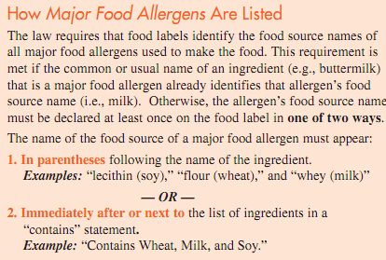
Figure 2A. Federal Mandate of 2004 (http://www.fda.gov/downloads/Food/ResourcesForYou/Consumers/UCM220117.pdf )

Slide 6
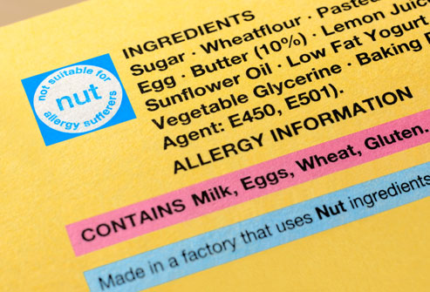
Figure 2B. Federal Regulation (Jan. 2006):

Slide 7
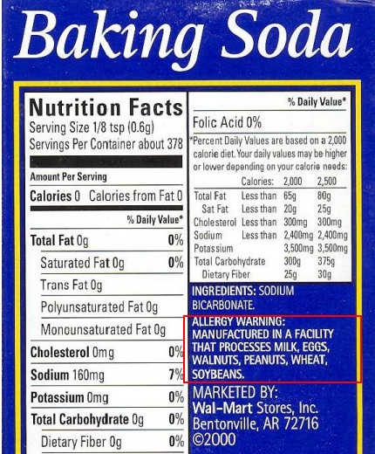
Figure 2C. Federal Regulation (“May contain”) FDA Public Hearing (September 2008): "Advisory warnings are confusing, inconsistent, and do not provide adequate information to make smart and safe decisions“ http://www.webmd.com/food-recipes/news/20080916/food-allergy-labels-too-vague

Slide 8
Model
A monopoly manufactures a product that may contain an allergen.
Seller:
Chooses level of care, y, which stochastically reduces allergen content a
Consumers:
Decide
whether to enter the market
how much effort, x, to allocate to reading the label
whether to buy the good
A firm and consumers make their decision simultaneously.

Slide 9
Regulation and Information
The product is potentially risky if a > a₀
Under mandatory disclosure, the firm is required to post the warning message if a>r.
Disclosure standards:
Stringent if r < a₀
Exact if r = a₀
Consumers know about regulation and product’s value and price
the mandatory disclosure r
the standard for transparency of the warning label b
value v and price p
Consumers do not know
Level of care y or allergen content a

Slide 10
Figure 3. Stringent Regulation
Product with warning labels
Density of Allergen Content Distribution
Potentially unsafe product
r
a₀
a
Critical level for disclosure
Allergen tolerance level

Slide 11
Figure 4. Timeline for decision-making
Consumer of type τ decides whether to participate in the market
Firm chooses y and consumer chooses x(τ)
Firm learns a, a~G(, y)
Firm discloses if a>a_{o}
Consumer detects allergens with probability f(x,b) conditional on disclosure
Consumer decides whether to buy the product

Slide 12
Model Details
The marginal cost of production m(y) weakly increases in care
Consumer’s individual susceptibility to allergen is τ
If a consumer gets sick, they incur harm h but can recover l
l is the liability rule
Consumers’ assessment of the product risk is proportional to the true risk
λ measures the risk perception of consumers

Slide 13
Cost and Benefit of Reading Labels
Assumptions
A constant marginal cost of reading a label is c>0
Consumer discovers an existing warning message with probability f(x,b)
Detection increases in x and b
Updating the Prior
No discovery can occur because there is no warning or because it was not found or understood by consumers.
Reading effort allows consumers to reduce the probability that the product is unsafe.
The optimal reading effort is chosen by consumers to equalize the marginal benefit and cost of reading labels.

Slide 14
Updating the Prior
After spending effort x on allergen label detection, the posterior probability of the product being unsafe (conditional on non-detection) is
where

Slide 15
Consumer Payoff
Purchase decision
Effort decision
Participation decision

Slide 16
Consumer Problem: Key Results
Consumers’ optimum reading effort
Decreases in firm care (strategic substitutes)
Increases in transparency of the warning message
Increases in risk perception by consumers
Decreases as the liability system becomes stronger

Slide 17
Consumer Results:
Claim 1. Consumer reading effort x*
Increases in b,r,p,τ,h,λ
Decreases in y,l,v,a₀,c
Claim 2. Consumer market participation
Increases in y,b,r,v,a₀
Decreases in l,p,h,c,λ

Slide 18
Figure 5. Equilibrium Effort by Consumer
x*
No participation
0
τ_{D}
τ_{E}
τ

Slide 19
Producer Problem:
Firm’s profit from consumer τ is:
where demand is
and expected consumer harm is

Slide 20
Producer Problem: Key Results
Claim 5: Under weak liability, the optimum level of care y* increases
if consumers spend more effort (strategic complements)
if the warning message gets more clear

Slide 21
Strategic Complements
where demand is
Three terms in square brackets (all positive)
cost of care savings
disclosure
liability cost

Slide 22
Producer Results (Continued):
Claim 5: The optimum level of care y*
Increases in x,b,l,p,h
Decreases in r
under uniform prior distribution G(⋅)
Is unaffected by v, c, λ
Is unaffected by a₀
under uniform prior distribution G(⋅)

Slide 23
Figure 6. Stronger Liability Rule (l )
y
R_{x}, Consumer reaction function
Higher l shifts:
R_{x} left (x*(•) is down)
R_{y} up (y*(•) is up)
R_{y}, Firm’s reaction function
E₁
Equilibrium moves from E₀ to E₁
Reduction in x*
Increase/Decrease in y*
E₀
x

Slide 24
Figure 7. Higher Visibility of Warning Messages (b)
y
R_{x}, Consumer reaction function
Higher b shifts:
R_{x} right (x*(•) is up)
R_{y} up (y*(•) is up)
E₁
R_{y}, Firm’s reaction function
Equilibrium moves from E₀ to E₁
Increase/Decrease in x*
Increase in y*
E₀
x

Slide 25
Figure 8. Higher Risk Perception (λ)
y
R_{x}, Consumer reaction function
Higher λ shifts:
R_{x} right (x*(•) is up)
R_{y} is the same
R_{y}, Firm’s reaction function
E₁
Equilibrium moves from E₀ to E₁
Increase in x*
Increase in y*
E₀
x

Slide 26
Conclusion
(Preliminary) Policy Recommendations:
Improved product safety may be achieved with
stronger liability
higher transparency of the warning message
higher risk perception by consumers
To do next:
Analyze the overall effects on expected harm
Analyze firm’s choice of price and transparency
Welfare analysis

