Slide 1
Yield Revenue Management and Costly Consumer Search MOSCOW 2012 June 8
Simon P. Anderson, University of Virginia, USA
and
Yves Schneider, University of Lucerne Switzerland

Slide 2
Back-drop
Cruise-ship mergers; can they be pro-competitive? (D Scheffman)
Likewise, airlines, hotels, etc
Yield Revenue Management: lots of OR, almost all monopoly
Competition is tough to analyze
(Dudey, Varmas & Vettas)

Slide 3
Order of events
Monopoly problem
Duopoly, no search costs
Duopoly with search costs
non-binding then binding
Results with capacity choice
Some evidence
Discussion of assumptions

Slide 4
Take-aways
Duopoly can be worse than monopoly
Higher prices for duopoly
In presence of search costs

Slide 5
Monopoly problem
Simple version
L consumers arrive sequentially in given order, do not return
Valuations i.i.d.
Capacity K; ignore discounting
What do prices look like?
Rise / fall over time depending on previous success

Slide 6
Value V(Ɩ;k)
V(0;k) = 0
V(Ɩ;k) = π Ɩ for k ≥ Ɩ (monopoly price & profit for each “period”)
V(Ɩ;1) : drop price over time until sell
V(Ɩ;k) concave in Ɩ and k (decreasing marginal benefits)

Slide 7
Solving value
Let valuations be drawn from F(p) in [0,1]
with (1-F) being (-1)-concave
Then program with Ɩ left is:
V(Ɩ;k) = max_{p} { F(p)V(Ɩ-1;k)
+ (1-F(p))(p + V(Ɩ-1;k-1) }
Two events.
Foc: p - (1-F(p))/f(p) = V(Ɩ-1;k) - V(Ɩ-1;k-1)
MR = MC governs choice over time
For linear demand, p = (1+MC)/2
Notes:
Spend time on MR = MC !

Slide 8
Working backwards
Think of Ɩ falling and k falling as sales are made; work back from final states
Build up solution recursively

Slide 9
Linear demand, 3 consumers, k=2
(k≥3 is just p=1/2 throughout), similarly
V(2;2)= ½ ; V(1;1)= V(1;2)=¼ (& V(0;k)=0)
¿V(2;1) ? : MC of selling is V(1;1)-V(1;0)=¼
So price is 5/8. Hence the value V(2;1) is
(5/8) V(1;1) + (3/8)(5/8 + V(1;0)) = 25/64
To find p_{3,2}, note MC is V(2;2)- V(2;1) = 7/64
So price is 71/128 (etc!)
Notes:
Walk it slowly!

Slide 10
Price patterns: rises if a sale and falls if there was no sale

Slide 11
Duopoly analysis
Suppose capacities K₁ and K₂.
Consumers arrive sequentially, see both prices, buy from cheaper.
Then disappear, never to return.
If one stocks out, the other firm is a monopoly henceforth (we already know the monopoly)

Slide 12
Duopoly, no search cost
If both capacities exceed Ɩ, prices are zero by standard Bertrand argument.
If one has stocked out, the other follows the monopoly program
The one with higher capacity may let the other win in order to precipitate getting the monopoly position

Slide 13
Duopoly example
Assume L=3, K₁ = K₂ = 2
To solve this, we must find V₁(2; k₁, k₂) and V₂(2; k₁, k₂)
If no sale to Ɩ=3, values are zero henceforth
So consider V₁(2; 2, 1) and V₂(2; 2, 1)
If 1 makes the sale to Ɩ=2, both expect nothing thereafter, so 1 would rather 2 sells (“CTD”)
If 2 sells, then 1 is a monopoly after, with expected profit 1/4

Slide 14
Duopoly with no search cost, ctd
Hence 1’s opportunity cost is ¼, so 1 undercuts 2 at any higher price for Ɩ=2
Equilibrium thus has p₂ = ¼ and 1 Clears the Decks of 2
Now consider Ɩ=3
If neither sells, they both get nothing, if either sells, they BOTH get ¼.¾ continuation, plus whatever current revenue.
So they bid p₃ down to zero (and not below)

Slide 15
Capacity and duopoly

Slide 16
Duopoly take-aways
“Clear-The-Decks”: exacerbate asymmetries, let other go first
Cournot-like capacity game
Lower prices than monopoly, higher welfare
More extended: not clear CTD holds; Vettas, Dudey unfinished (?) work

Slide 17
Duopoly with search costs
Suppose the first search / observation is free (and random across the 2 firms)
Second search costs c
Consumers know their order of arrival (e.g., time of day) and how much capacity is left at each firm
2 cases; search cost prohibitive, or maybe binding
[recall Diamond Paradox]

Slide 18
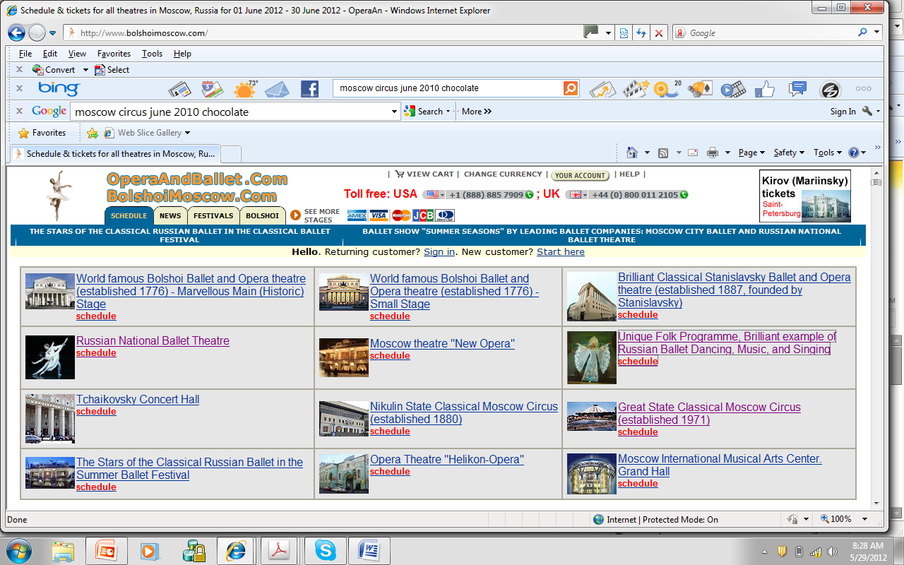
Duopoly with positive search cost (c large)
Firm 1 is to max by choice of p₁
½{F(p₁)V₁(Ɩ-1;k₁,k₂)+(1-F(p₁))[p₁+V₁(Ɩ-1;k₁-1,k₂)]}
+ ½{F(p₂)V₁(Ɩ-1;k₁,k₂)+(1-F(p₂))V₁(Ɩ-1;k₁,k₂-1)}
Note that 1 can’t affect second part, so just chooses price against first part; like the monopoly problem in structure (other’s impact through k₂)
Solve by working back

Slide 20
Notes:
What price expect? DP: 5500r !

Slide 21
(prohibitive) search cost example
Suppose Ɩ=3 & K₁=K₂=1
Last consumer, either a monopoly with profit ¼ or a duopoly with profit 1/8 (Diamond Para)
and monopoly prices
Ɩ=2 : if no prior sale, what is opp. cost? 1/8
So price is 9/16 (above monopoly levels for 2 units of capacity and 2 consumers)
Similar for both firms, so now find p₃

Slide 22
First find V₁(2;1,1) :
Recall V₁(Ɩ;k₁,k₂)=
½{F(p₁)V₁(Ɩ-1;k₁,k₂)
+(1-F(p₁))[p₁+V₁(Ɩ-1;k₁-1,k₂)]}
+ ½{F(p₂)V₁(Ɩ-1;k₁,k₂)
+(1-F(p₂))V₁(Ɩ-1;k₁,k₂-1)}
With now p₁=p₂=9/16; so
V₁(2;1,1)=
½{(9/16)(1/8)+(7/16)(9/16)}
+ ½{(9/16)(1/8)+(7/16)(1/4)} = 127 / 512

Slide 23
Firm 1 is to max by choice of p₁
½{F(p₁)V₁(2;1,1)+(1-F(p₁))[p₁+V₁(2;0,k₂)]}
+ ½{F(p₂)V₁(2;1,1)+(1-F(p₂))V₁(2;1,1)}
And V₁(2;1,1) = 127/512 and V₁(2;0,k₂)=0;
so opp. cost is 127/512 and price is
639/512 ≈ 0.624 (using monopoly pricing rule)

Slide 24
Example summarized
higher price under duopoly than monopoly
(0.624 compared to 0.555)
duopolists also demand a higher p₂ if no sale was made to first consumer (0.5625 compared to 0.5)
Joint expected profits of the duopolists are V₁(3;1,1)+V₂(3;1,1)≈0.691
monopolist has V^{m}(3;2)≈0.698

Slide 25
(more simply – higher duop OC)
2 periods and one unit each
Monopoly would be price ½ each pd
Duopoly set higher prices first period because consumer won’t search, and also Opp. Cost is 1/8 profit at end
So price 9/16

Slide 26
Asymmetric capacities e.g.
Last e.g. had same prices, so no role for search
Suppose 2 consumers, K₁=2, K₂=1. Find price path
If 2 sells out, 1 is then a monopolist for the last consumer remaining. Sets p₁ = ½, profit ¼
If 1 sells, Diamond result: p₁ = ½, profit 1/8 each, same as if 1 doesn’t sell
So for Firm 1, p₂ = ½
Firm 2, opp cost is 1/8, so its p₂ = 9/16
Smaller firm has higher price (expected?)
And its price is unconstrained if c≥ 1/16. Otherwise…
Notes:
Before was CTD

Slide 27
Asymmetric capacity; c < 1/16
Then Firm 2 is constrained: candidate equil sets ½+c
Does Firm 1 want to deviate to CTD by setting a high price? NO
Never find CTD here, always want to be in contention, perhaps at high price

Slide 28
lower search costs discipline Lo-capacity firm, Lo is worse off, Hi better because Lo Clears quicker

Slide 29
Proposition 3. Let the duopolists be endowed with initial capacities K₁ and K₂, respectively.
If K₁ + K₂ ≥ L then a monopolist initially endowed with capacity K₁ + K₂ charges p^{m} for each unit while duopolists always charge a price of p^{m} or above.
Welfare is higher under monopoly than under duopoly.

Slide 30
K1 + K2 < L: numerical methods.
Proposition 3 holds more generally:
Result 1. Simulations for uniform valuations and search costs c = 0.05 confirm
Proposition 3 for L < 100 and all capacity levels. (no reason to expect different results for L > 100, for different search costs, or for different distributions of valuations)

Slide 31
capacities

Slide 32
welfare
Lower for duopoly because higher prices
Reason is higher duopoly Opp. Cost
Still have a shot of a sale next time even if other still has capacity, because consumer may come to you first
Hence monopoly can be more efficient market form here

Slide 33
On (heroic) assumptions
Costless first search: standard in (early) search literature, otherwise Diamond hold-up
- Stiglitz twist of down-slope demand: more complex here! (AR heterogeneous consumers?)
Consumer knows state: may know time of day of visit, but how know how much cap left? Diamond Paradox may “help” – don’t expect lower prices elsewhere, so don’t search

Slide 34
Sum-up
Competition can raise prices and lower welfare
Because higher opp. costs – firm can still sell later when monopoly has zero benefit from capacity
Context of capacity constraints and costly consumer search
Revenue management and oligopoly with (and without!) frictions deserves more work
www; role of comparison sites?

